Slide 1
Narrative explanation of visualization encoding scheme
Wang, Qianwen
2017.01.12

Slide 2
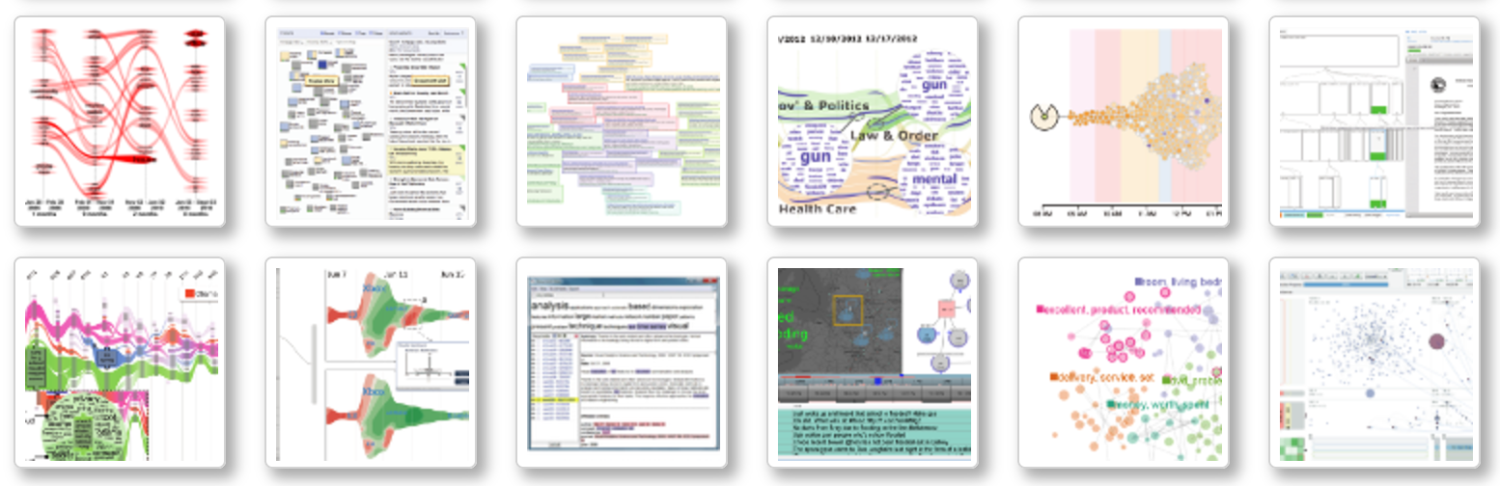
Motivation
Advanced visualization technology
Data with high dimension
Large datasets
Identify trends, similarities

Slide 3
Motivation
Advanced visualization technology
overwhelming information harm the understandability and memorability
Difficult to present, especially for novice
Little exposure outside visual community due to relatively long study period

Slide 4
Motivation
Narrative explanation can be a solution!
Specify the reading order
Bring information density down
Pre-defined narrative templates
Less study burden
Increase understandability and memorability
Guideline for presentation
time

Slide 5
Contribution
An authoring tool to generate narrative slideshow for visualization explanation
General audience:
a tool to understand advanced visualization technology
People inside visualization community:
An authoring tool to generate narrative visualization.
A guideline: how to present a visualization
A notebook: record how themselves digest this paper, facilitating later share and communication

Slide 6
Related works
Authoring tools for narrative visualization
Authoring Data-Driven Videos with DataClips (http://dataclips.azurewebsites.net/#home)
Temporal Summary Images: An Approach to Narrative Visualization via Interactive Annotation Generation and Placement
Stories in GeoTime
Tools for understanding visualization
Learning Visualizations by Analogy: Promoting Visual Literacy through Visualization Morphing
GraphDiaries: Animated Transitions and Temporal Navigation for Dynamic Networks

Slide 7
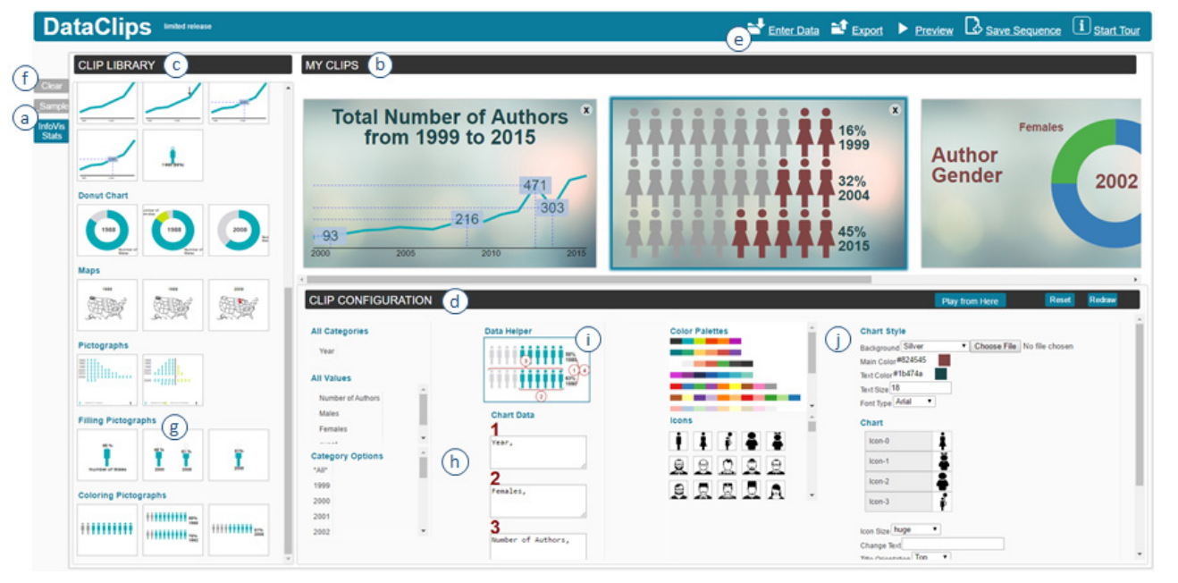
Authoring tools for narrative visualization
Help non-experts create data video
Offer a library of data-driven clips
Only apply naïve visualization design, no explanation needed
Offer no narrative templates
Authoring Data-Driven Videos with DataClips

Slide 8
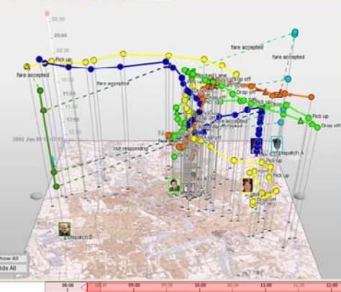
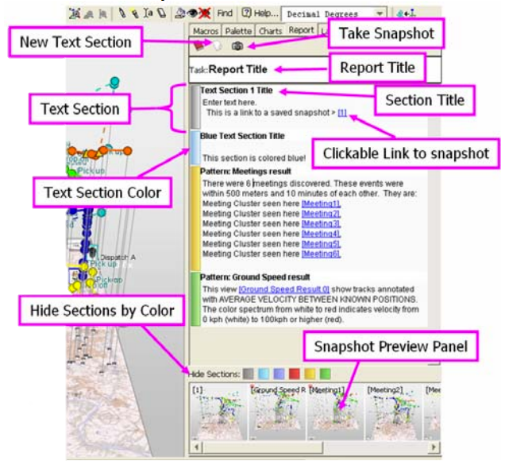
Authoring tools for narrative visualization
Add a story window to a visualization analysis tool
Allow snapshots and annotation for narrative comic strips
Have to explain encoding first by themselves
Offer no narrative templates
Stories in geo-time

Slide 9
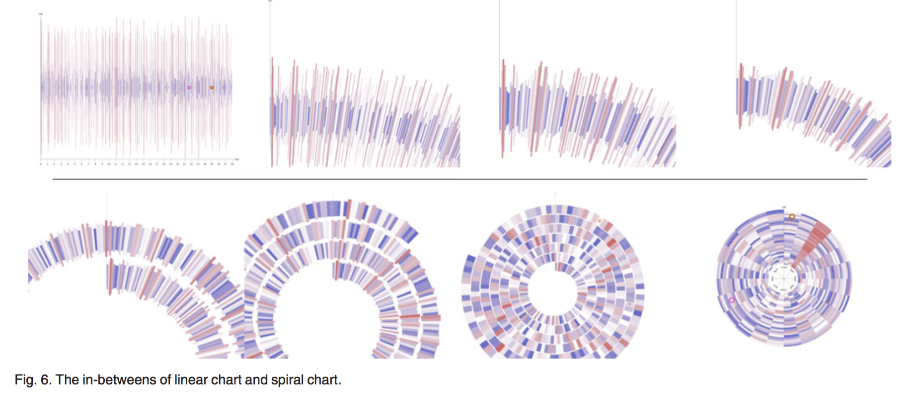
Tools for understanding visualization
Morphing from familiar visualization to unfamiliar visualization
source and target visualizations share a similar set of visual grammar
Help understand unfamiliar visualization
Only apply for visualization pairs that share same visual grammar
Based on the familiar of source visualization
No story, no data
Learning Visualizations by Analogy: Promoting Visual Literacy through Visualization Morphing

Slide 10
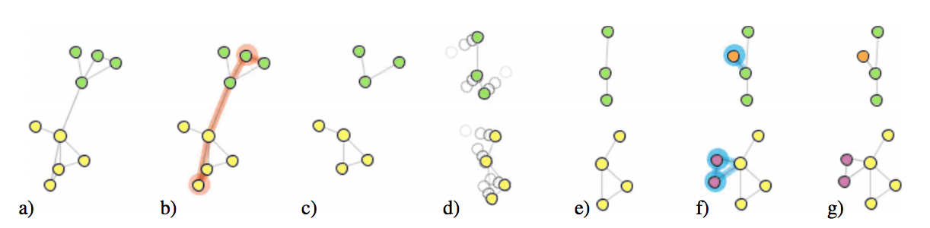
Tools for understanding visualization
Help understand dynamic network
Highlight the changes at each step
Only focus on one design - node-link
No explanation of encoding
Information density stay the same
GraphDiaries: Animated Transitions and Temporal Navigation for Dynamic Networks

Slide 11
New problem or old problem?
Old problem:
better understand visualization
New method:
The first authoring tool aiming to explain advanced visualization designs in the form of narrative slideshow

Slide 12
Survey Task
Narrow down the range of the survey
Two dimension
Area marks: easy to extract and reorganize
theme river-> text visualization
Collect all text visualization paper published on IEEE VIS
Summarize the commons in encoding scheme and visual design
Summarize how it is explained:
From paper
From presentation video

Slide 13
Design Tasks
Marks and channels extraction :
Marks：points, lines, areas
Channels：position, color, tilt, shape, size
Tasks identify:
Text：annotation, legends, design section, etc
Narrative logics:
The logic to explain one encoding element
The logic between each encoding elements
The logic to explain a case study (optional?)

Slide 14
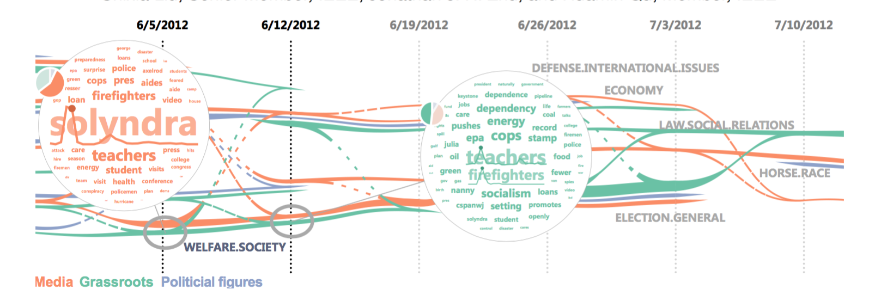
Initial design
Visual Analysis of Topic Competition on Social Media
Notes:
Based on the logic they are mentioned in the paper “5.2 visual encodings”

Slide 15
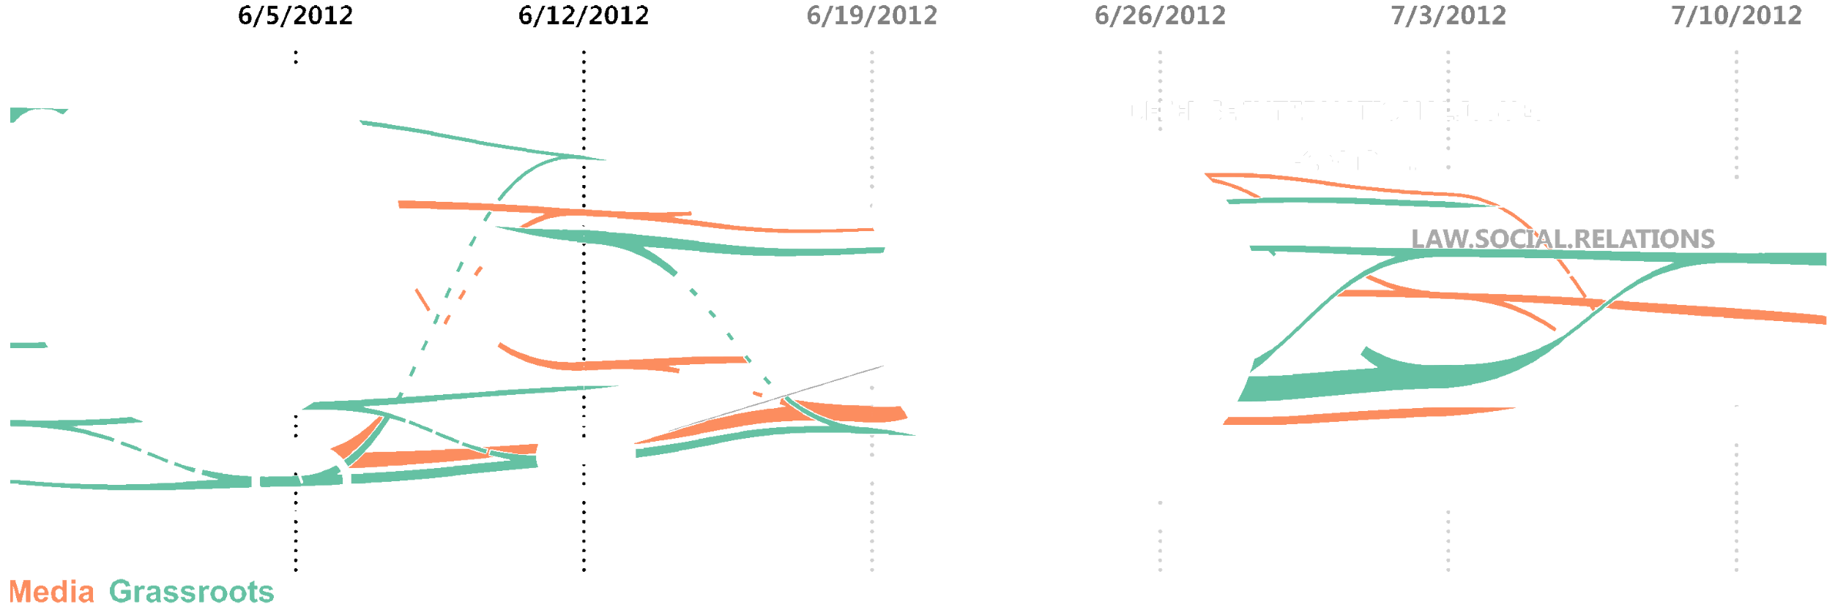
Initial design
The x- axis is time line

Slide 16

Initial design
Each layer -> a topic
The height of each layer -> the competitiveness of the topic
“Economy” is a more competitive topic than “horse race”

Slide 17

Initial design
Colors of the lines-> opinion leader groups

Slide 18
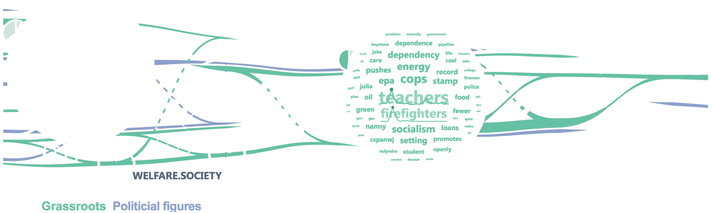
Initial design
Colors of the lines-> opinion leader groups

Slide 19
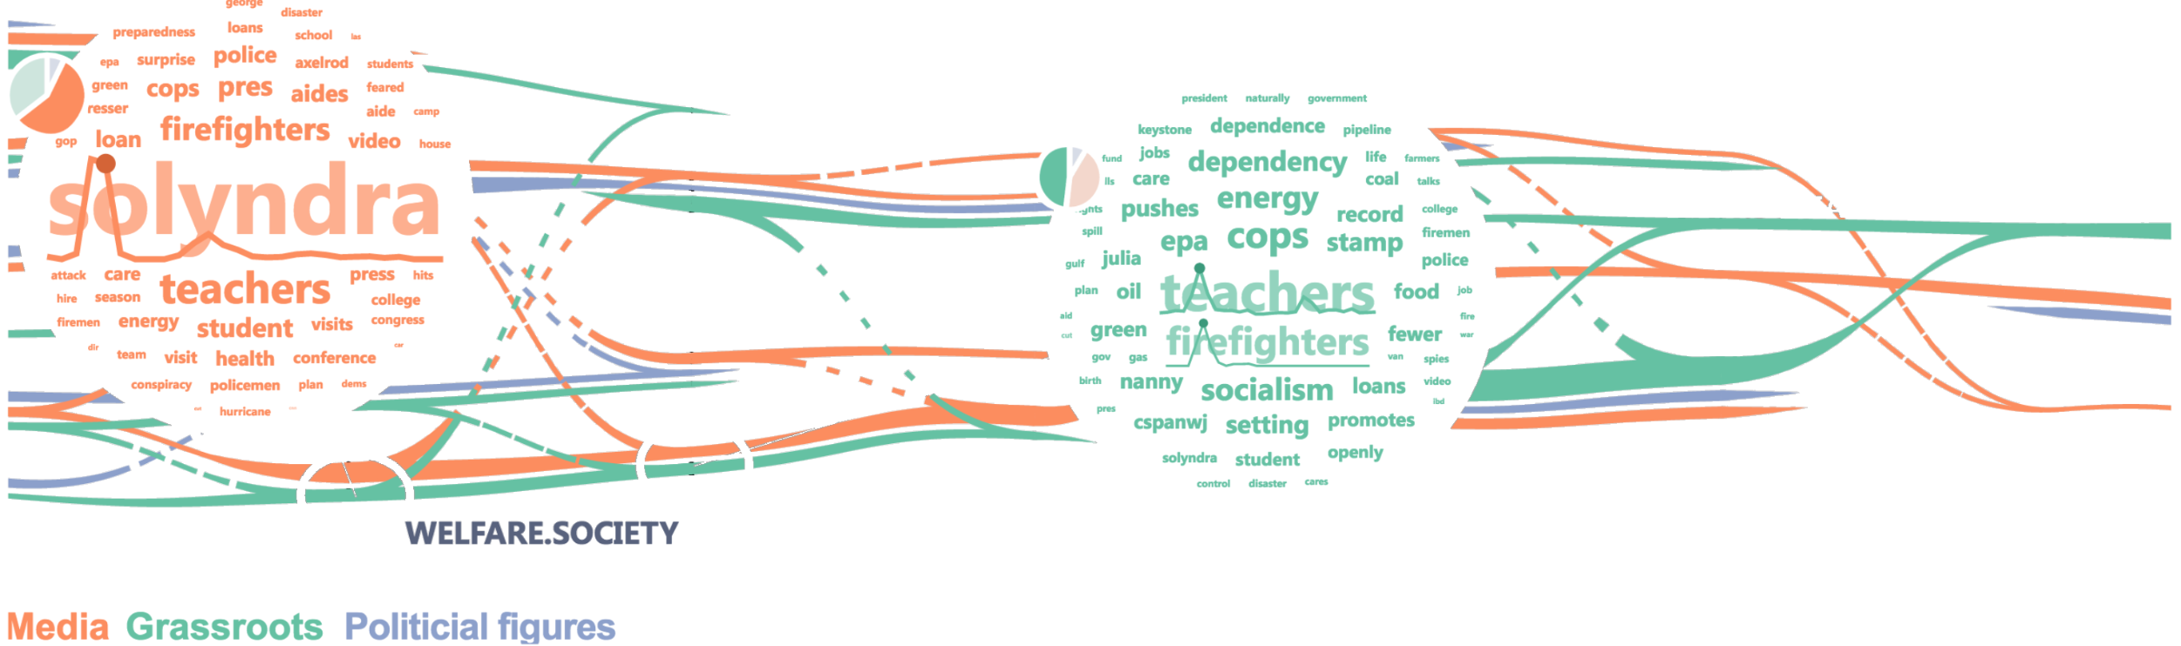
Initial design
Colors of the lines -> opinion leader groups

Slide 20
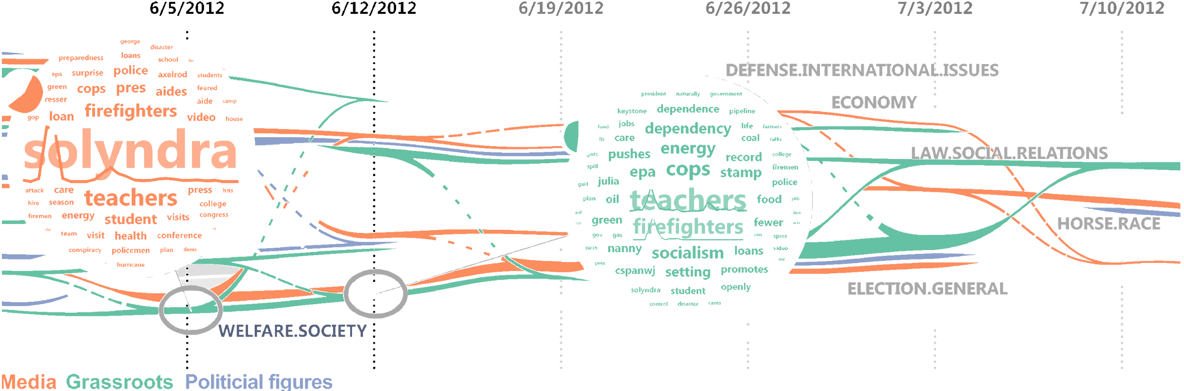
Initial design
The width of the lines -> the competitiveness contributed by each opinion leader group to a topic
7/3/2012, opinion leader group “grassroots” contributed more to the competitiveness of topic “election general”

Slide 21
Initial design
The transition lines -> topical transition
7/3/2012-7/10/2012, opinion leader group “media” change from topic ”economy” and “horse race” to topic “election general”.

Slide 22
Initial design
1
2
The density of the dots is -> the strength of the transition.
“2”is more strong transition than “1”

Slide 23
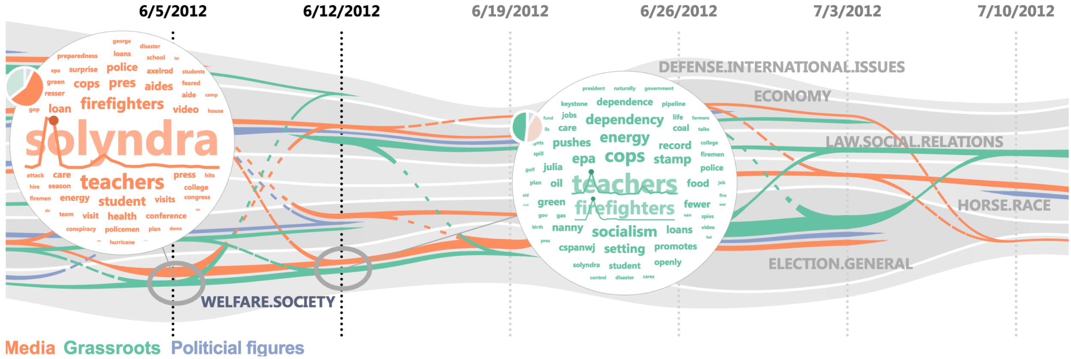
Initial design
The size of each word in the word cloud -> tf-idf (term-frequency inverse-document-frequency) measure(Words that only appear during specific time intervals are assigned higher importance. )
6/5/2012, at topic “welfare society”, opinion group talk the word “solyndra” most frequently

Slide 24
Initial design
a spark line -> temporal variation of the keywords’ occurrences for the selected entire time

Slide 25
Initial design
pie chart -> proportion of the competitiveness contributions of different opinion leader groups to the corresponding topic.

Slide 26
User study needed
Participants:
Insider VS outsider of visual community
Source:
Narrative slideshow of our system VS figures and text explanation
Metrics:
Understandability, memorability

Slide 27
Plan and milestone
date | idea | writing | coding
1.19 | Collect and read paper, videos about text visualization (start from theme river); | Survey related work; | Finish decomposition of a png figure
1.26 | Summarize narrative templates; Show examples for feedback; |  | Collect all target visualization designs published in IEEE VIS;
2.2 |  | Introduction and related work
2.9 | Refine the templates based on feedback; Continue survey and summarize; |  | Finish text and annotation extraction
2.16 |  | Narrative templates design | Online system: prototype
2.23 | User study design | Detection algorithm | Online system: interaction

Slide 28
Plan and milestone
date | idea | writing | coding
3.2 |  | 2 Case studies | Refine online system
3.9 | Experiment: user study
3.16 | Analyze user study data | User studies
3.23 |  | Conclusion and discussion
3.30 |  | Proof reading | Making video

Slide 29
Thanks!
Special thank to the authors of following websites:
http://textvis.lnu.se/
http://sentimentvis.lnu.se/
http://www.informatik.uni-rostock.de/~ct/timeviz/timeviz.html
http://ieg.ifs.tuwien.ac.at/~federico/LiPatVis/

Slide 30
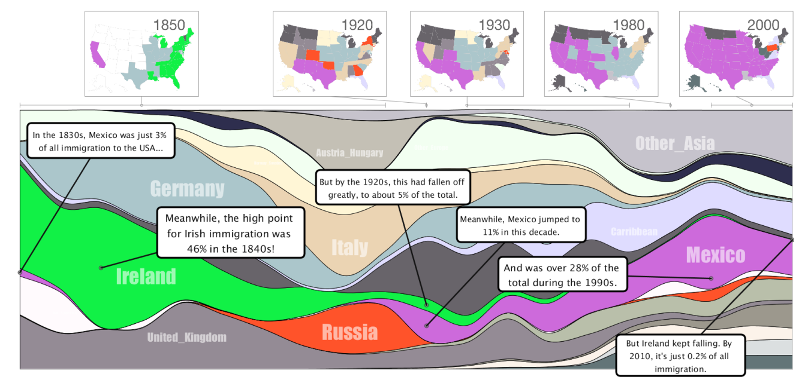
Authoring tools for narrative visualization
a temporal layout
comic strip-style data snapshots
textual annotations
Temporal Summary Images: An Approach to Narrative Visualization via Interactive Annotation Generation and Placement

Slide 31
Design details
Encoding scheme
Narrative template
Case study

Slide 32
Tasks
Bottom up:
Extract encoding elements from figures
Extract corresponding text from the paper
Animated transition library
Design storytelling templates:
E+I+P+R (dominant pattern in data videos)
E(I*P*)+R+ (more tension builders)
Design interactive interface,
Design and conduct user study

Slide 33
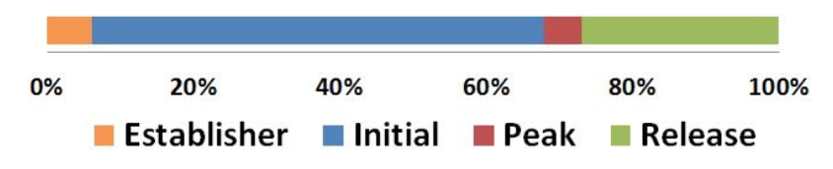
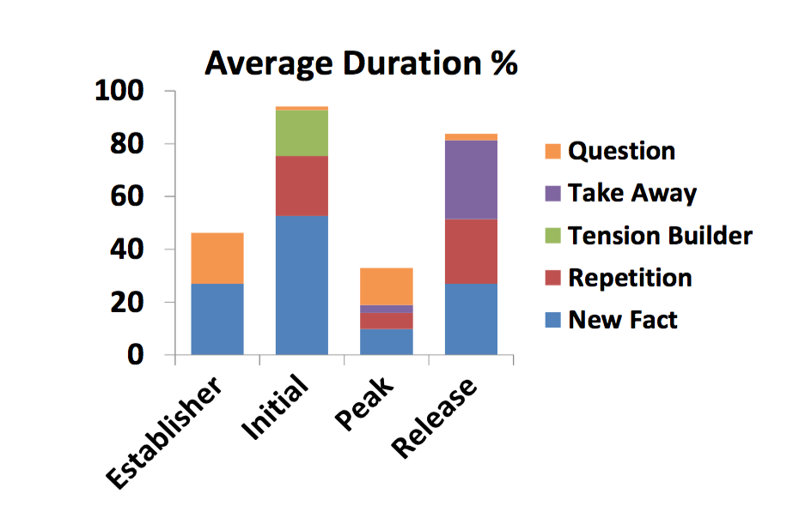
Narrative/storytelling
Cohn’s definitions for the four major narrative categories:
Establisher (E): sequences that “provide referential information without engaging them in the actions or events of a narrative.”
Initial (I): sequences that “set the action or event in motion.”
Peak (P): sequences where “the most important things happen; the culmination of an event or the confluence of numerous events.”
Release (R): sequences that show “the aftermath of the Peak.”
Story type: factual, tension builder, view points, inciting reflection
Narrative/storytelling
Understanding Data Videos: Looking at Narrative Visualization through the Cinematography Lens
Narrative Visualization: Telling Stories with Data

Slide 34
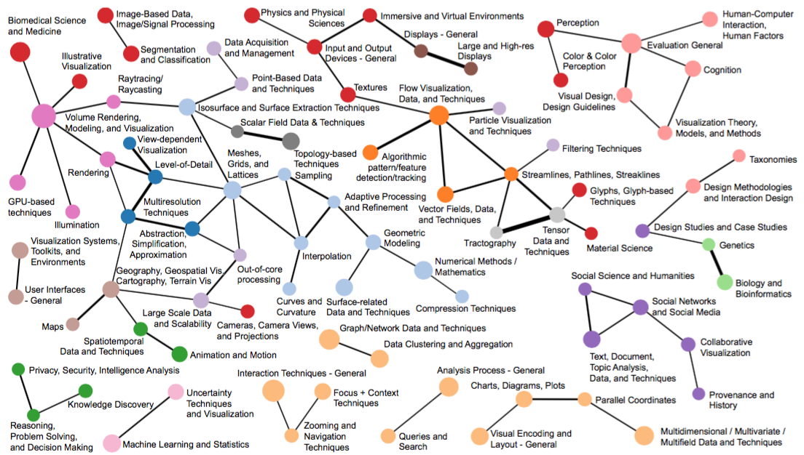
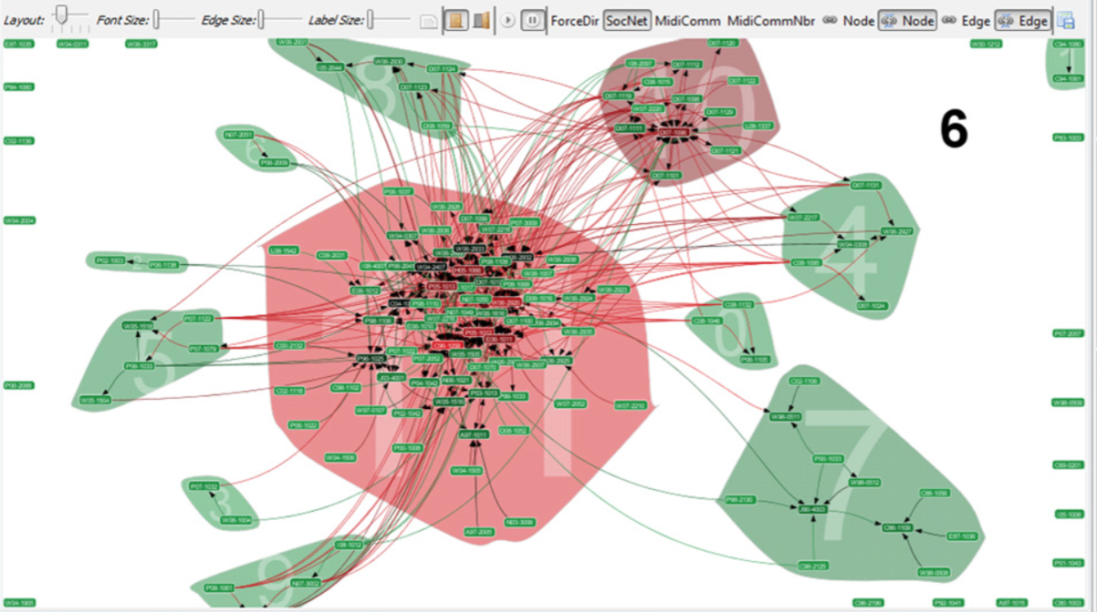
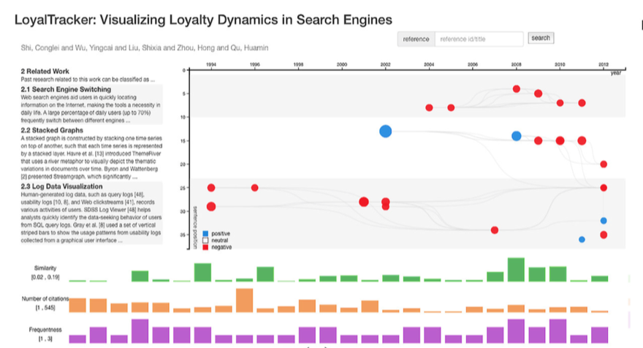
Visualization of research papers

Slide 35
Design details
Extract title, annotation, encoding elements from the figures
Highlight, arrows, circles
Blur unrelated parts (we usually do the same for vis videos)
Animated transition
Annotation: (extract from corresponding parts in paper)
Authoring tool:
Users are allowed to edit: the sequence of slides, annotation, animation effects,

Slide 36
Design details
Narrative template:
Encoding scheme
Case study

Slide 37
Story threading
Initialization/introduction:
Case studies: the order they are mentioned in the paper
Each case study: martini structure
End of each case study: conclusion, take home message

Slide 38
Initial design
We call this structure an interactive slideshow that uses single-frame interactivity
(Contrary to the martini glass, an interactive slideshow allows for interaction mid-narrative, a more balanced mix of author-driven and reader-driven approaches. However, individual slides often func- tion in the martini glass style, again communicating author-intended messages prior to prompting the user to interact with the display. )
prototype includes three main components:
Annotated pattern detection
narrative text authoring
story threading

